Slide 1
HAPPY SUNSHINE
IDM 215 002

Slide 2
Team Members
Steven
Tushar
Christine
Han
Marta

Slide 3
Introduction
Happy Sunshine is a popular food truck on Drexel’s campus
Well regarded for the owners personal and friendly atmosphere
Specializes in breakfast food & sandwiches
2 owners (husband & wife)
Notes:
Talk about the Happy Sunshine foodtruck
Images should be food truck?

Slide 4

Purposes & Goals
Product Purposes
Goals
Allow customers to order online and ahead
Add new payment methods
Introduce a rewards system
Improve customers’ waiting time
Design a product that resonates with the client’s brand identity and values
Create an application that is user-centric and using research to back up every UX decisions
Notes:
The challenge is to use UX processes to research the needs of the business, its customers, and its competitors to create a unique mobile ordering process that is on brand, succinct, and easy to use. (This was from the project brief packet that chelsea gave to us earlier in the term)

Slide 5

Research
Notes:
Design this

Slide 6
01
02
03
04
05
Fly on the Wall
Business Canvas Model
Project Canvas
Competition Research
Affinity Mapping

Slide 7
01
Fly on the Wall

Slide 8
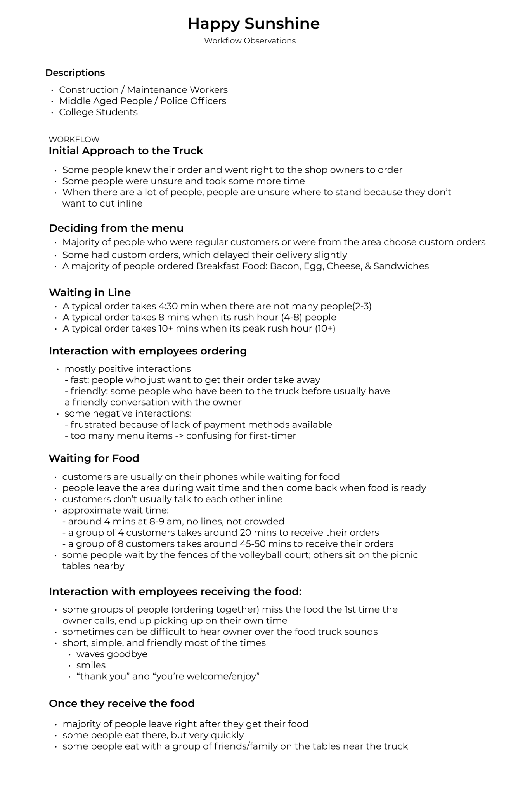
Fly on the Wall
Notes:
We started off with the fly on the wall technique where each team member chose a day to go and observe users of the truck. We documented

Slide 9
02
Business Canvas Model

Slide 10
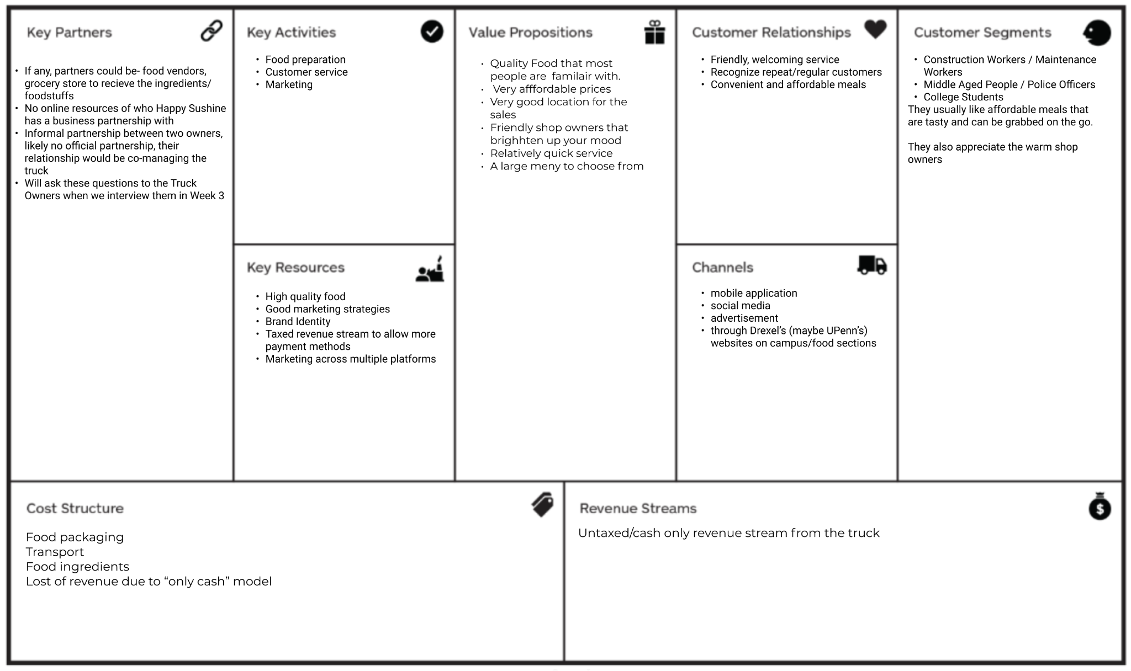
Business Canvas Model
Notes:
Value prop,
Cost structure,
Customer segment

Slide 11
03
Project Canvas

Slide 12
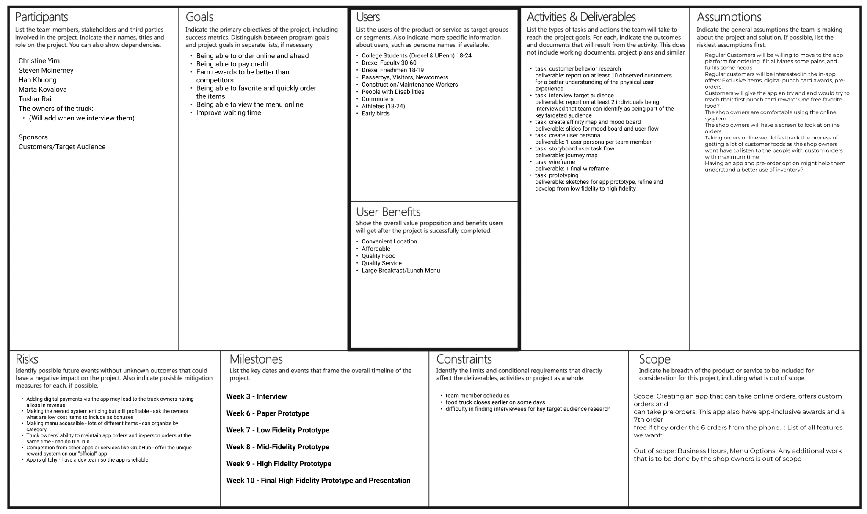
Project Canvas
Notes:
Main goals, users
Organise different aspect of thee project and define the scope

Slide 13
04
Competition Research

Slide 14
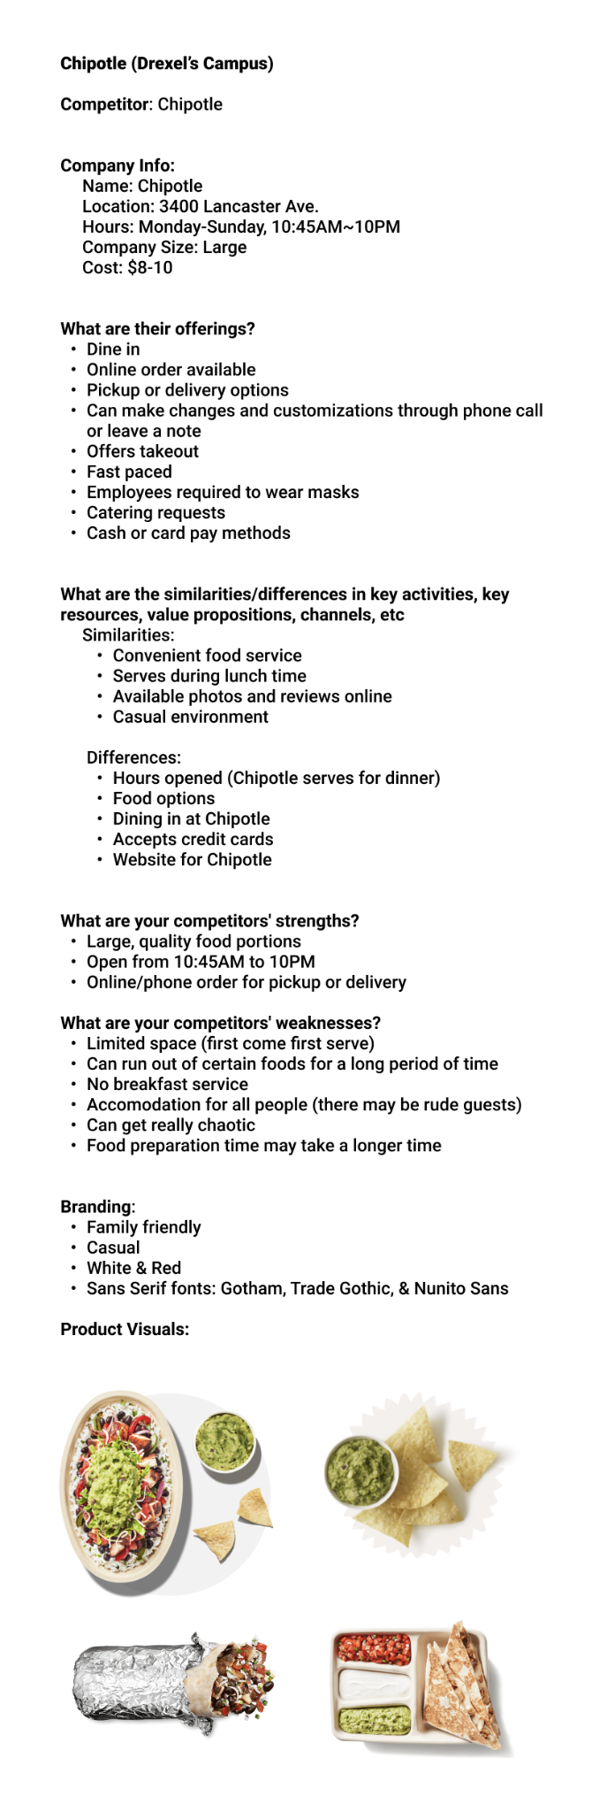
Competitor Research - Chipotle
Notes:
SWOT analysis

Slide 15
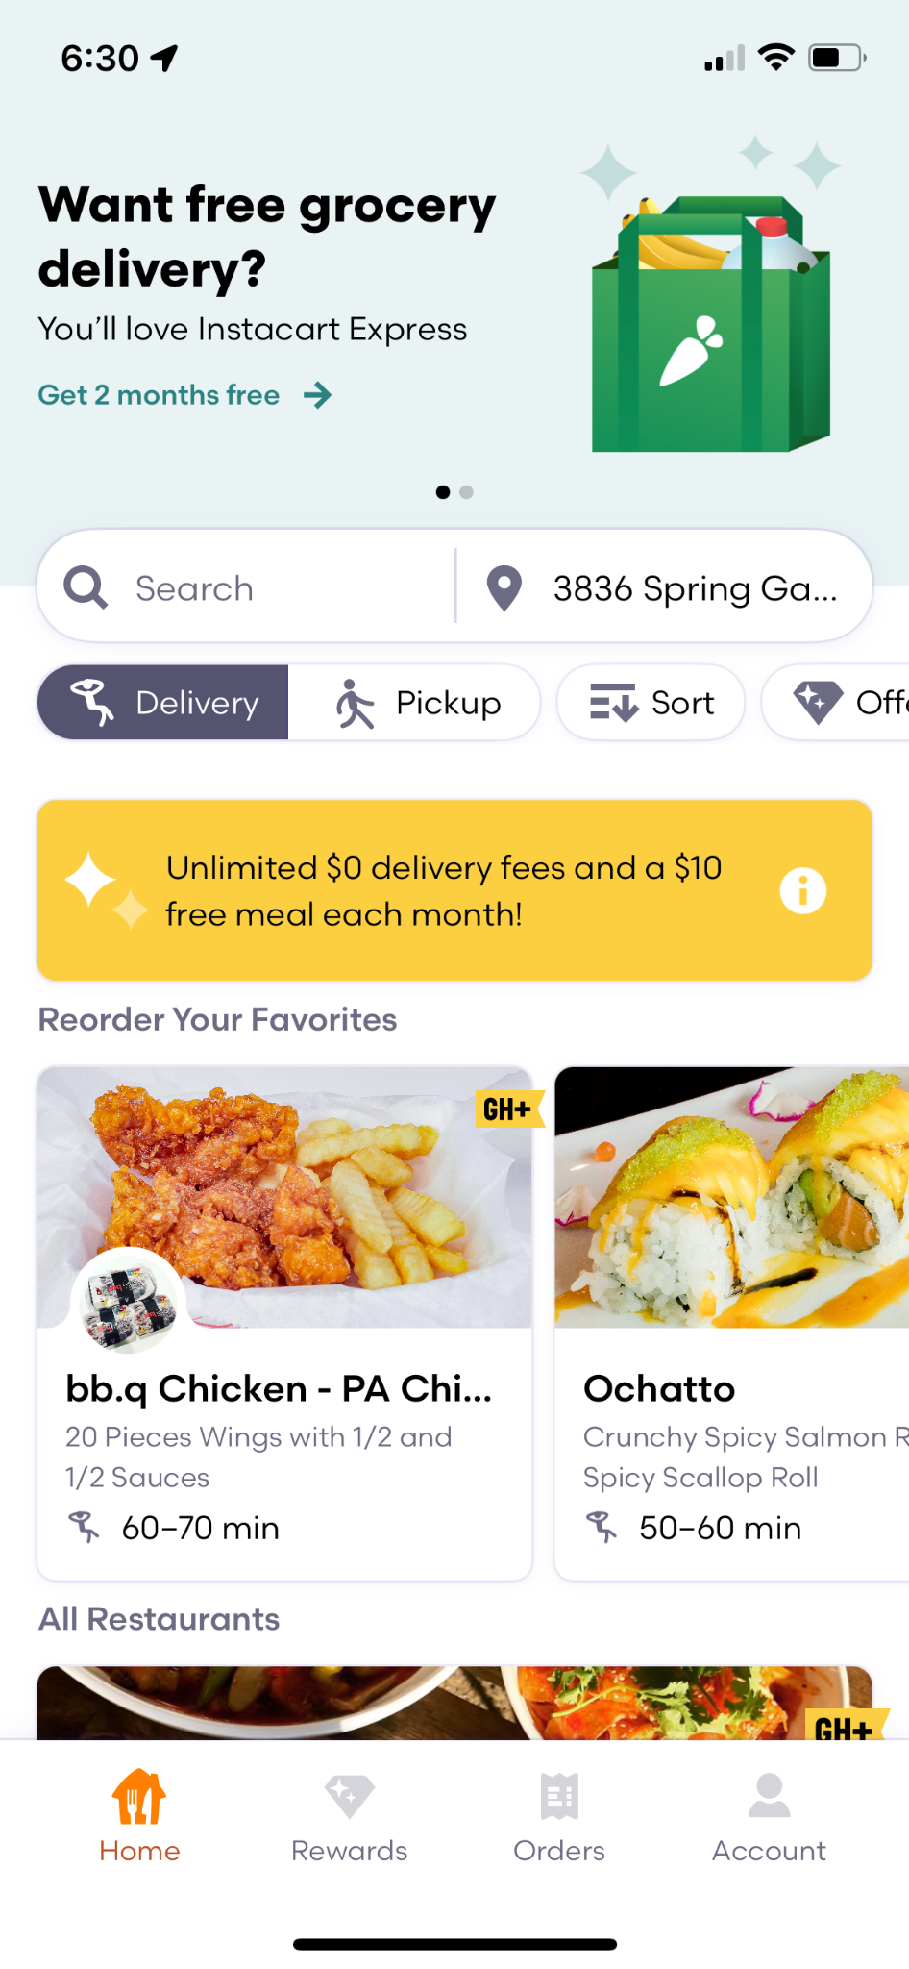
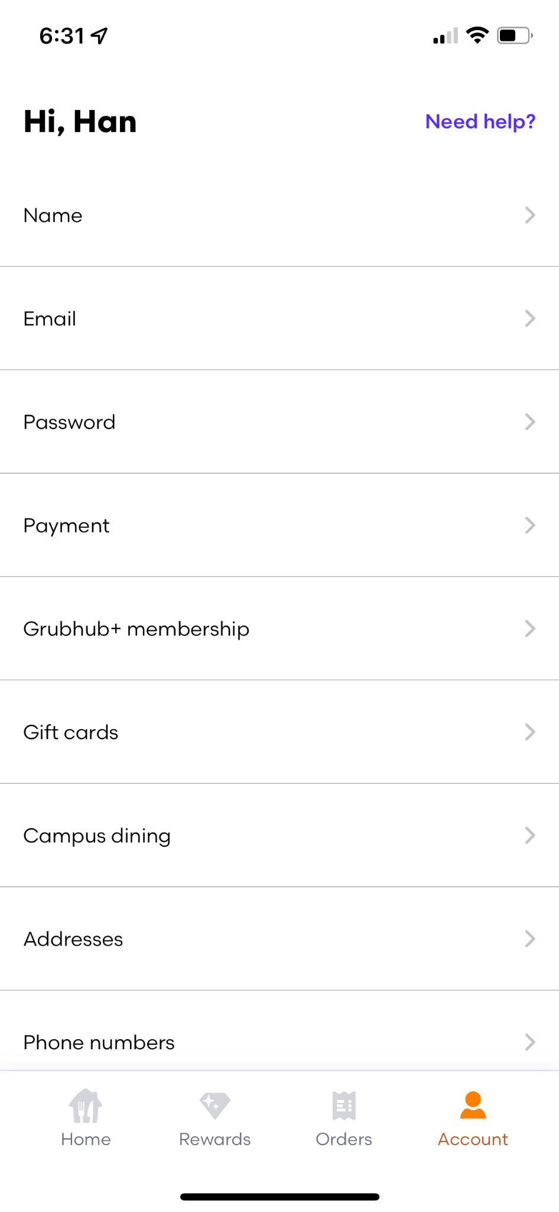
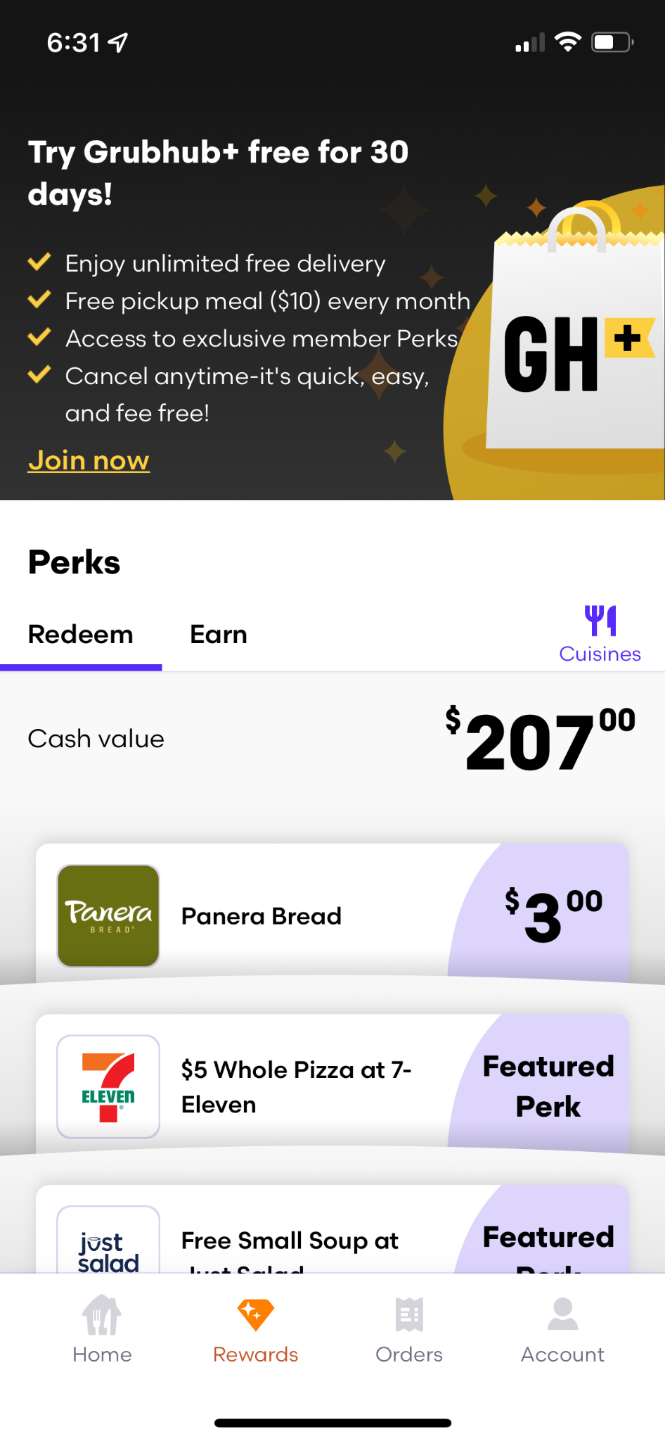
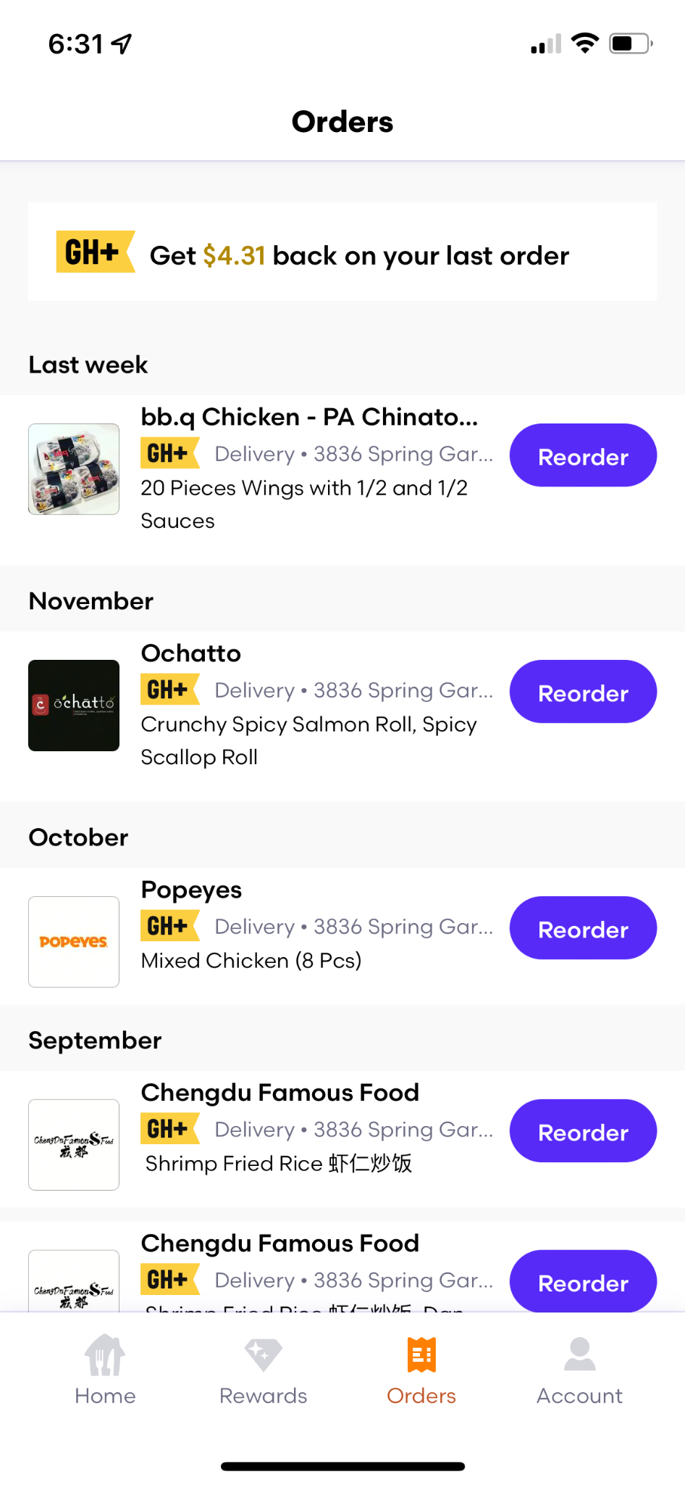
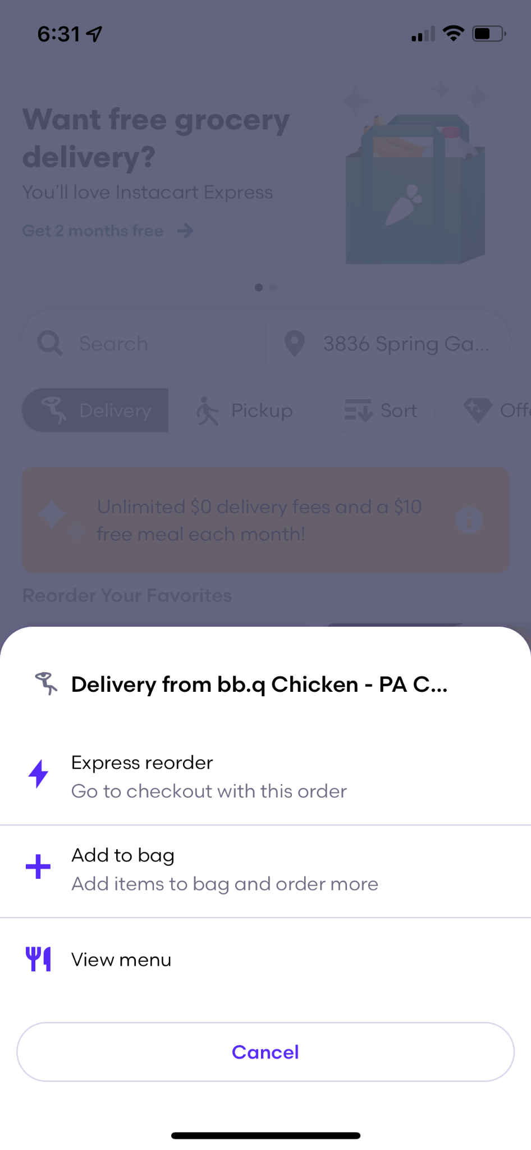
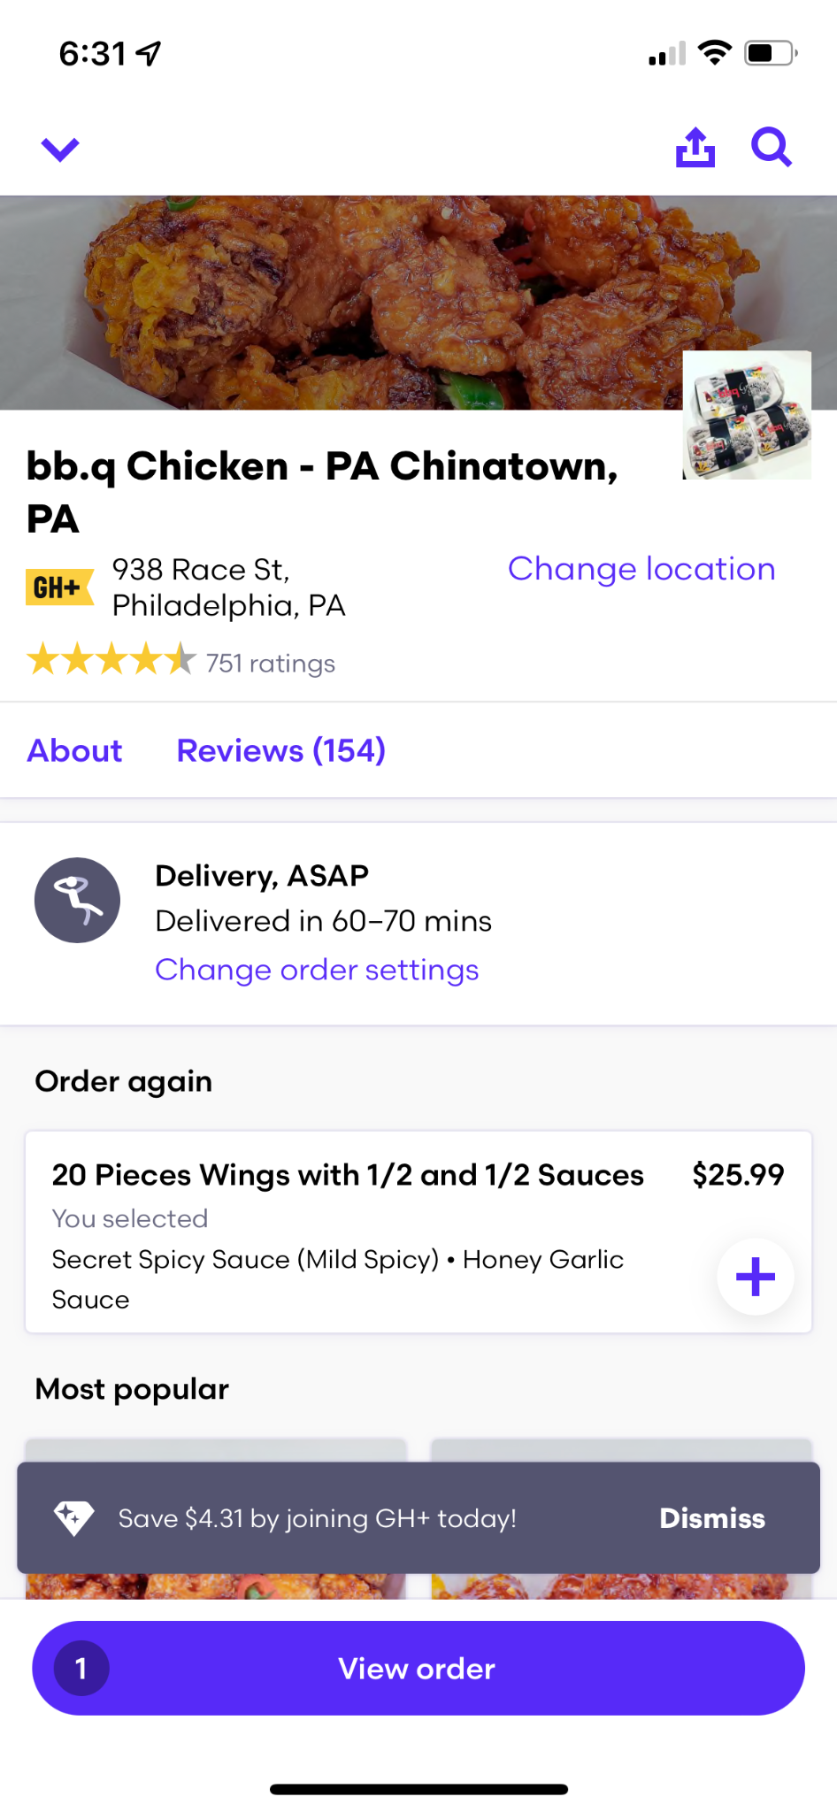
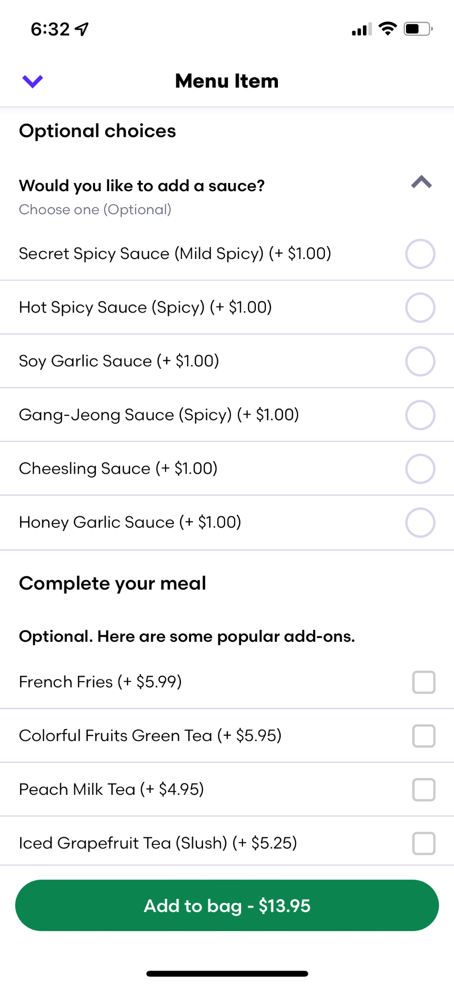
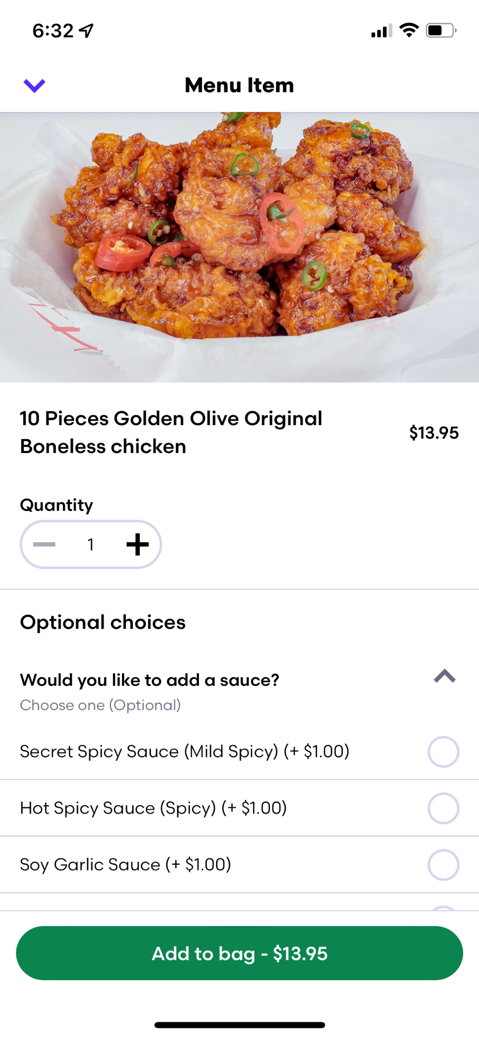
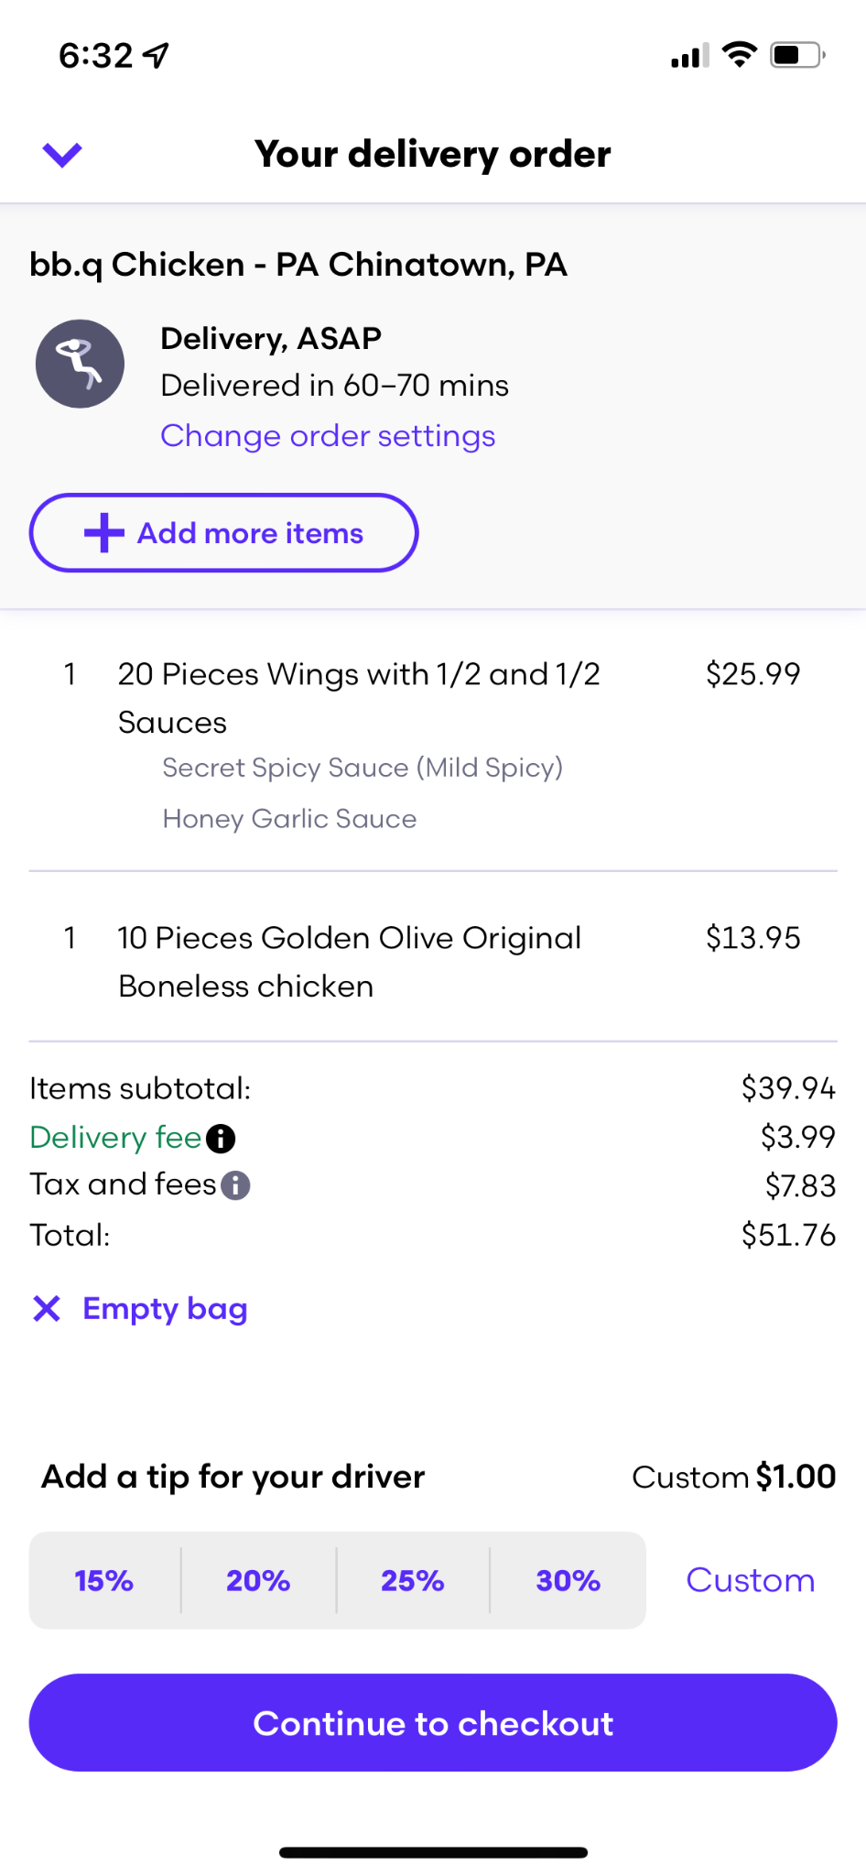
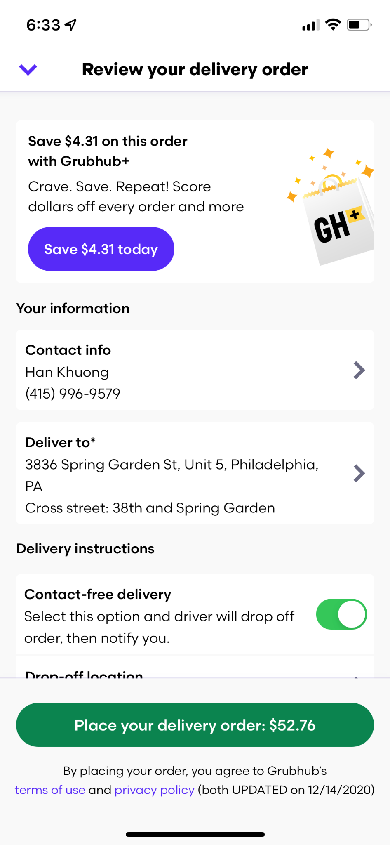
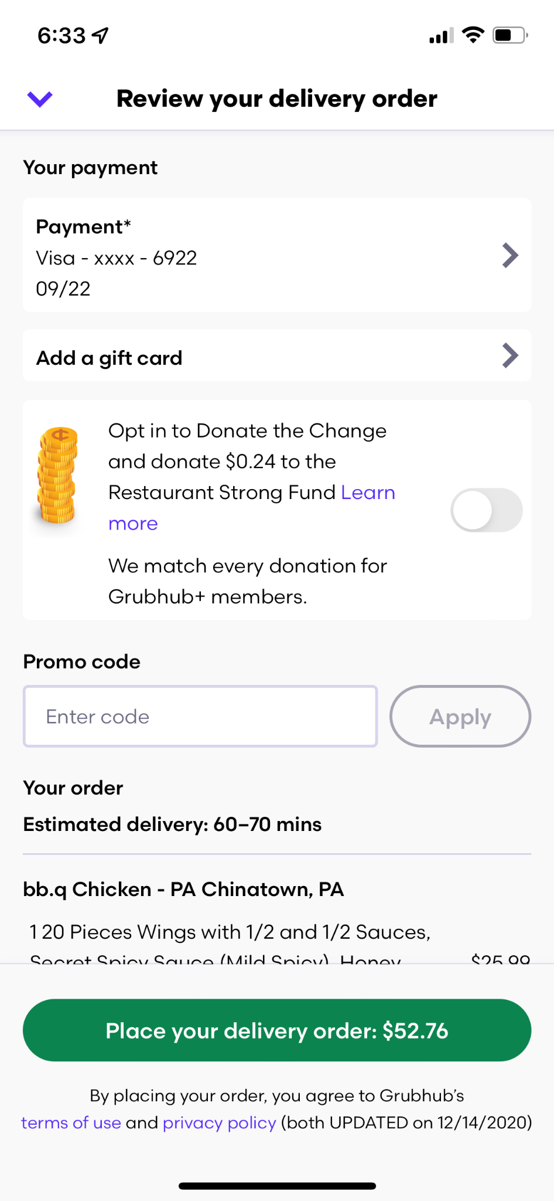
Competitor Research - Grubhub

Slide 16
05
Affinity Map

Slide 17
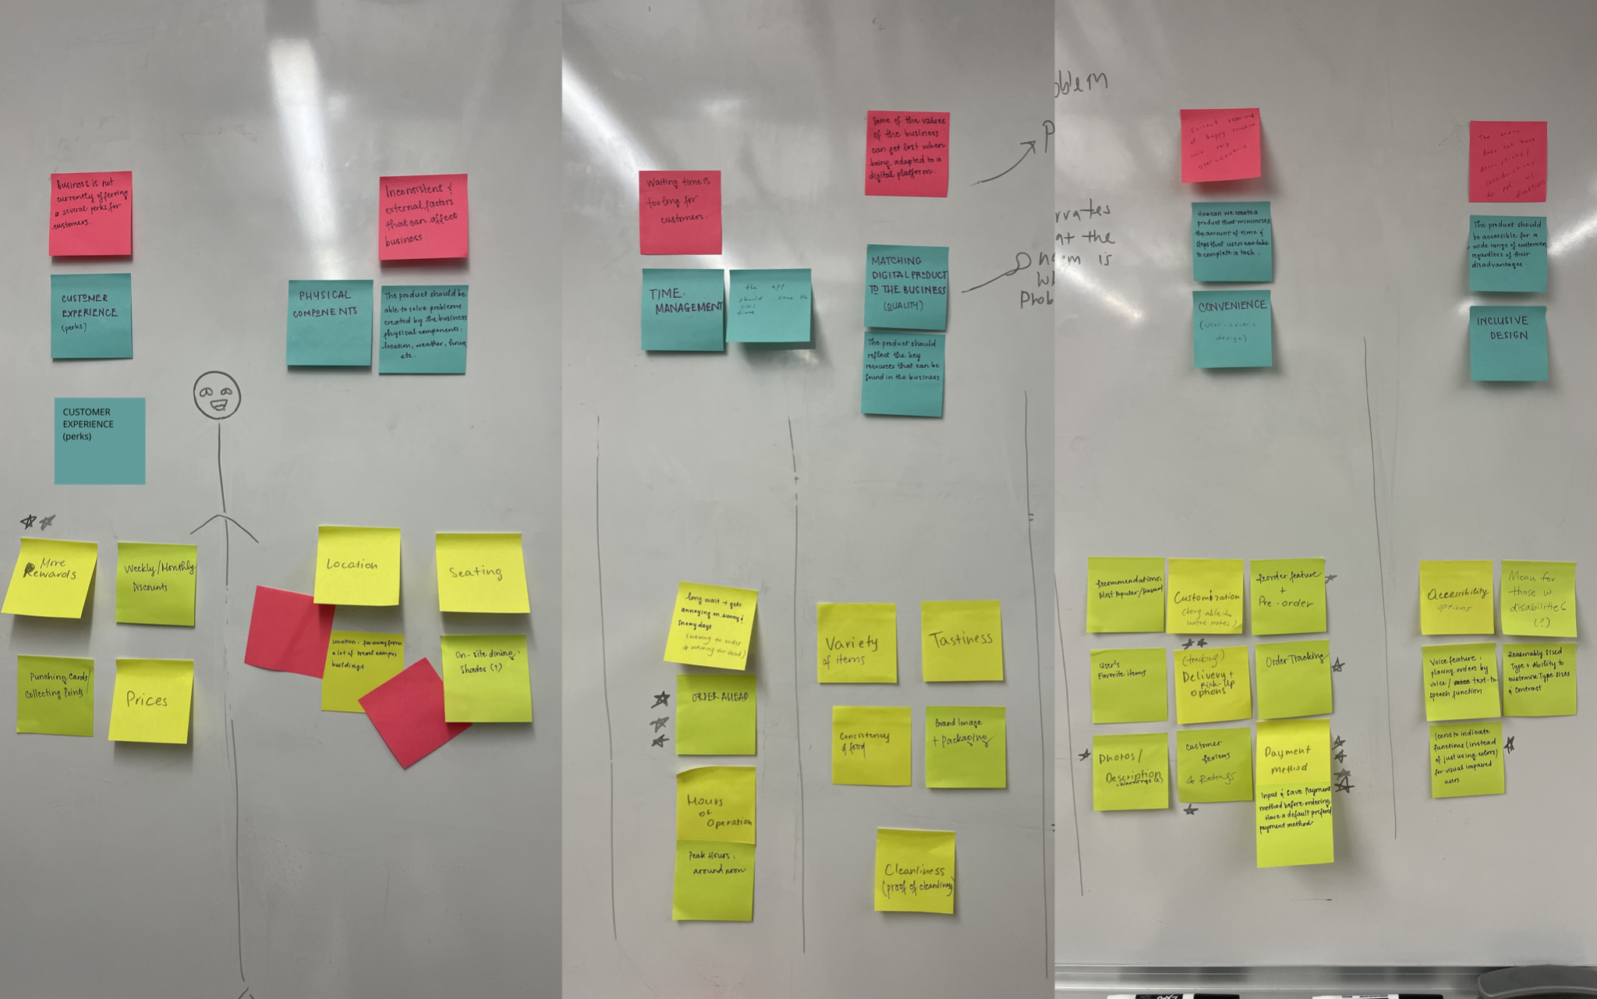
Affinity Map

Slide 18
Archetypes & Personas

Slide 19
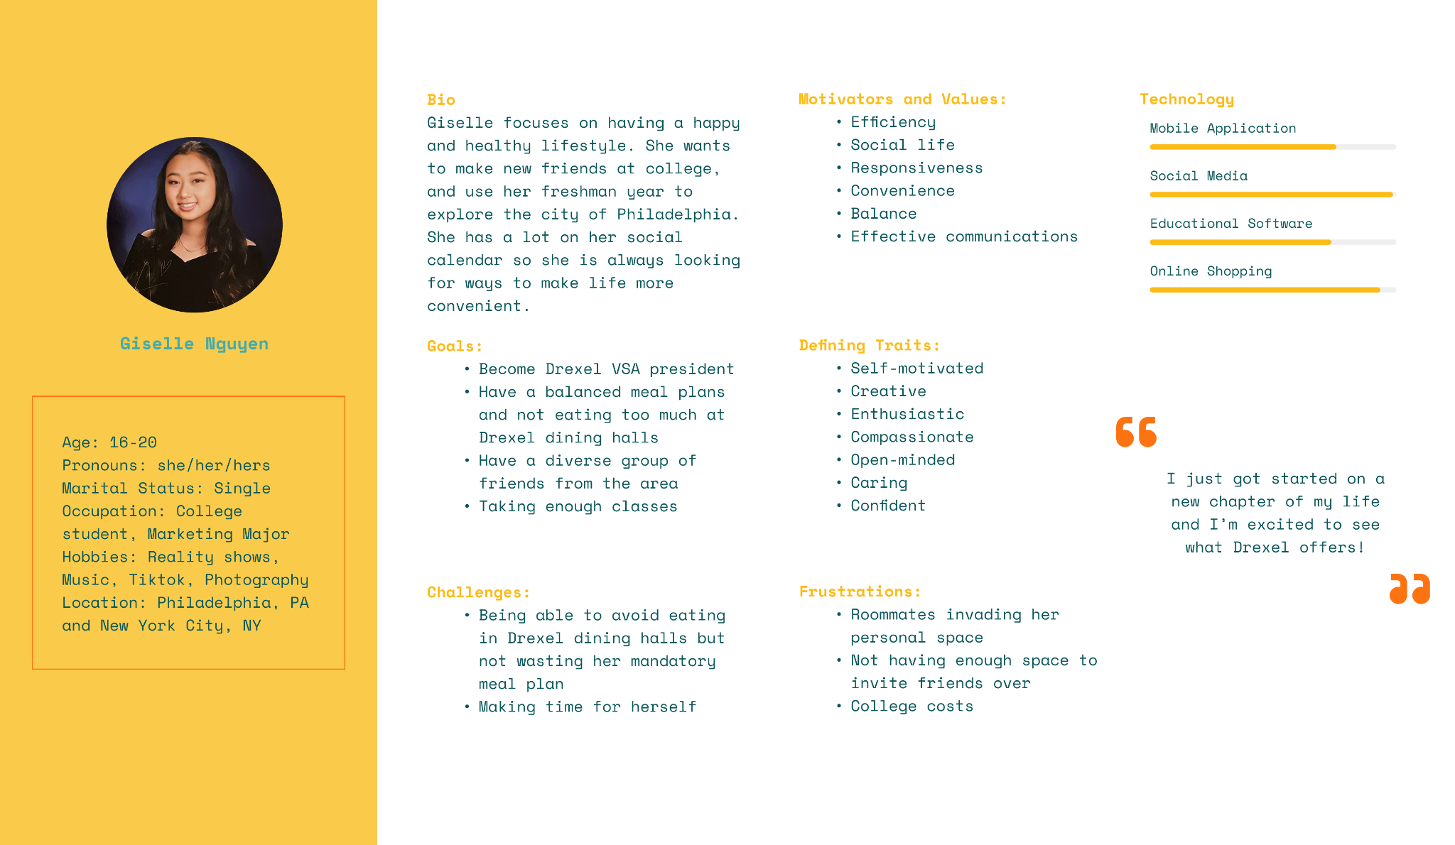
I. Students
Archetypes & Personas

Slide 20
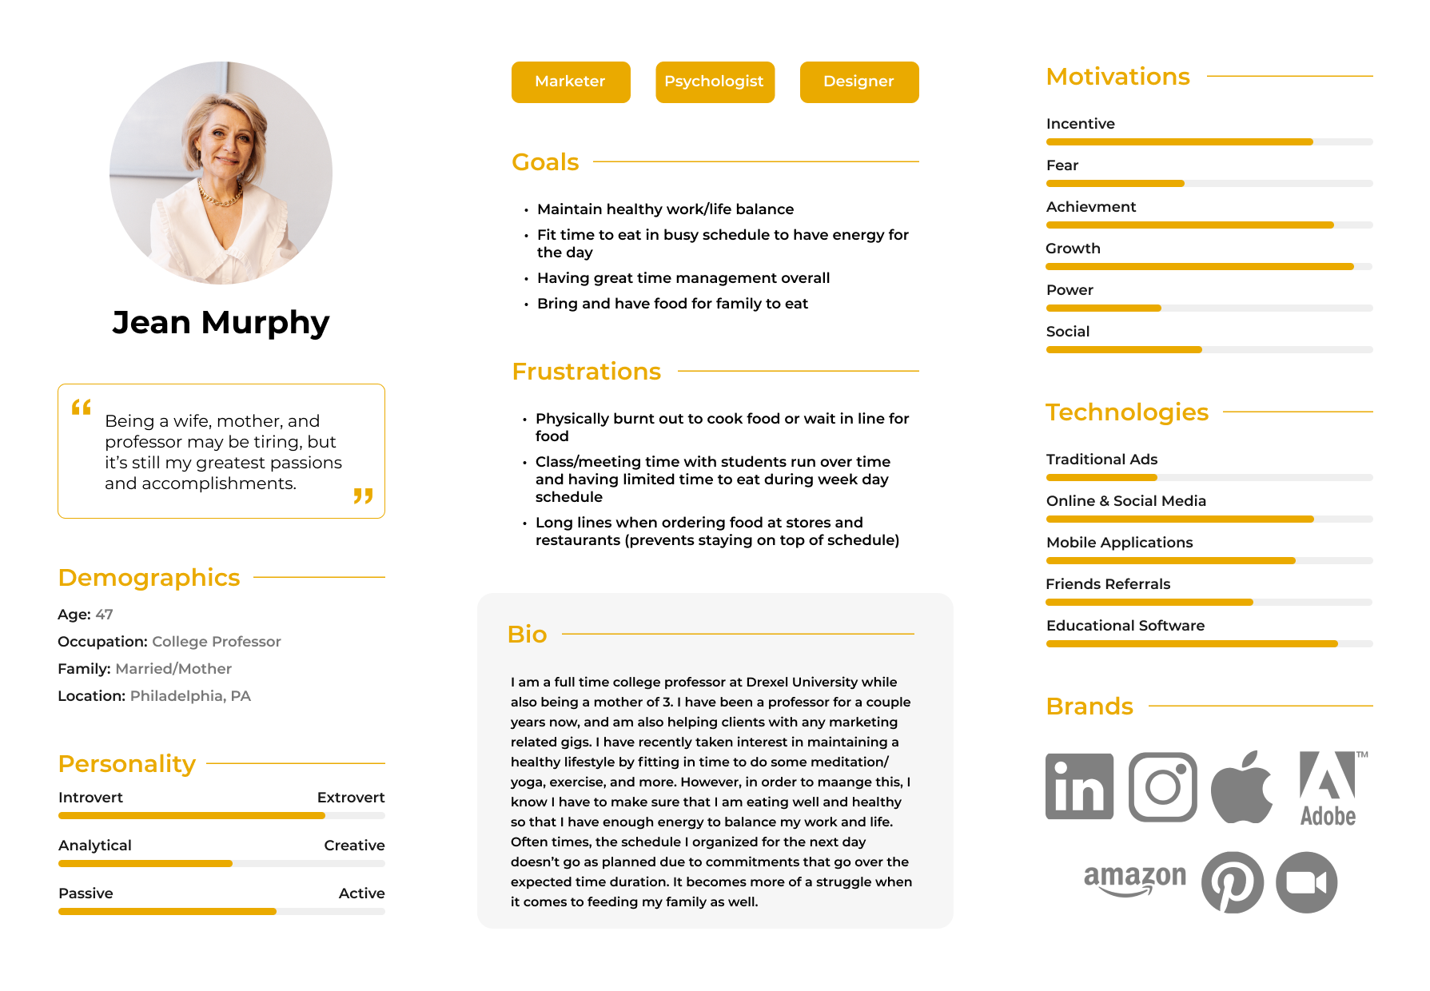
II. Professors/Staff
Archetypes & Personas

Slide 21
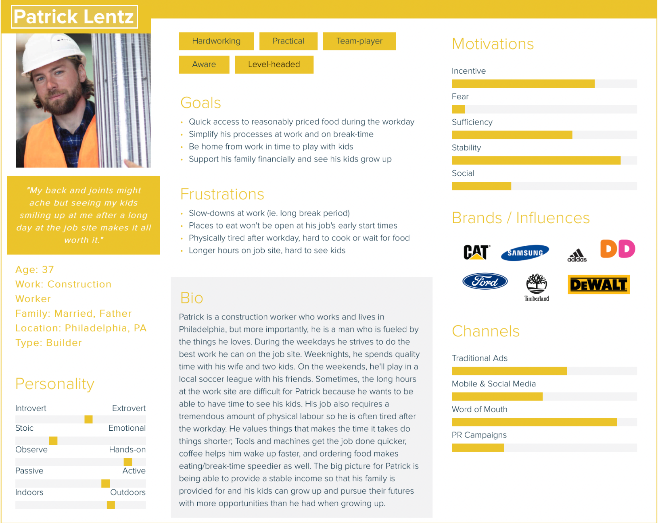
III. Maintenance/Construction Workers
Archetypes & Personas

Slide 22
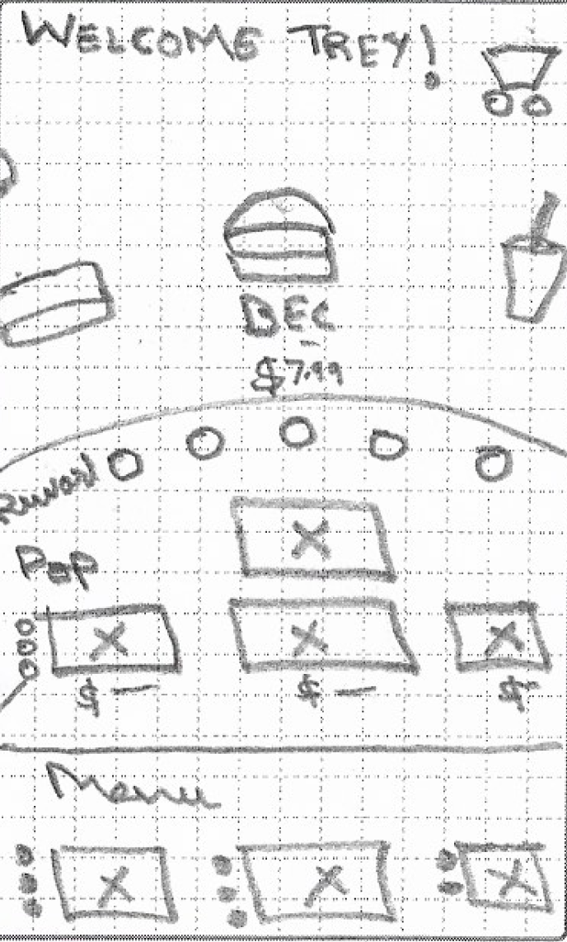
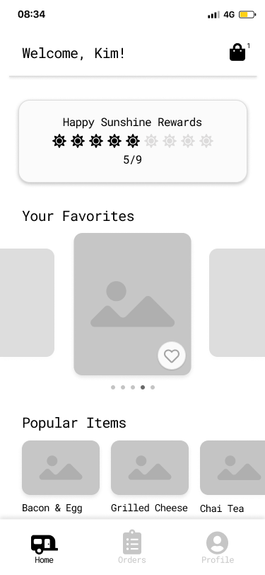
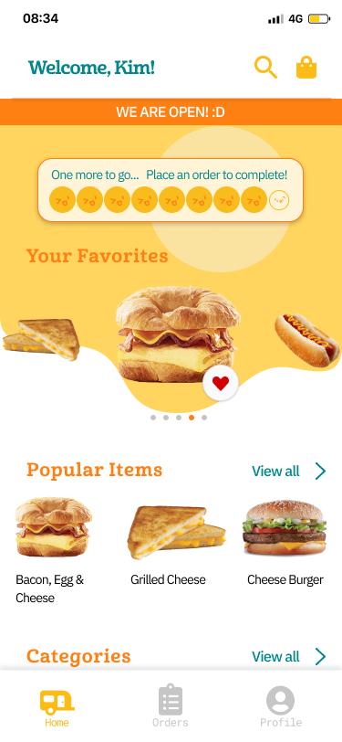
Project Progression

Slide 23
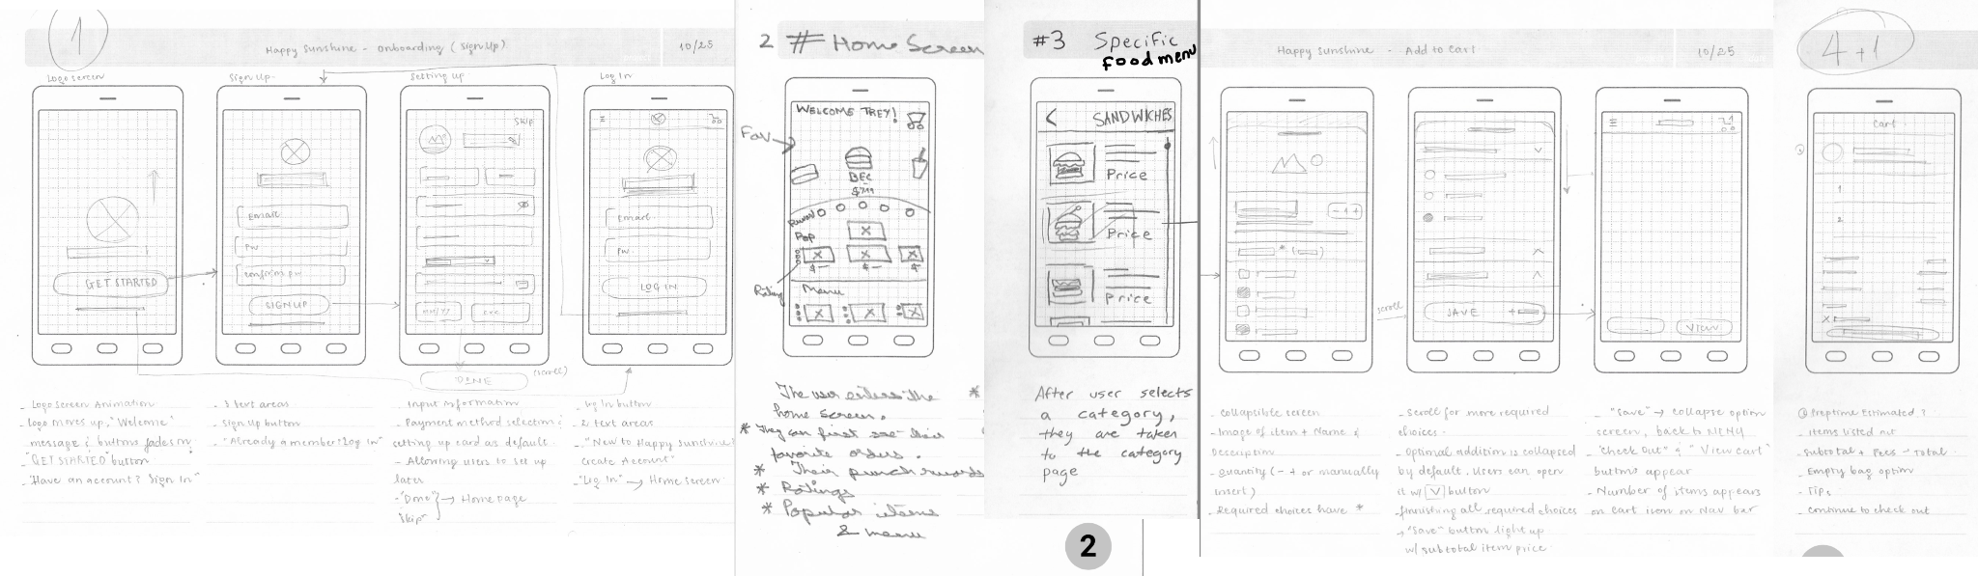
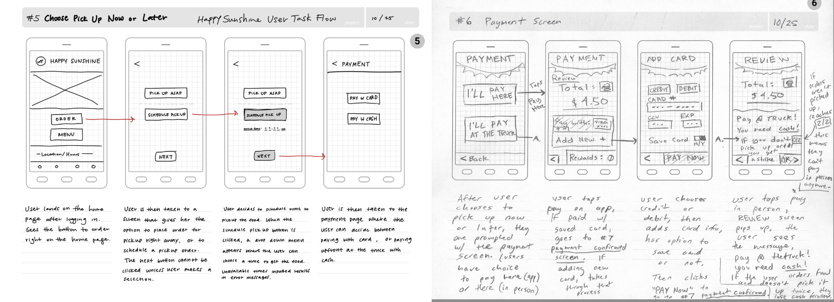
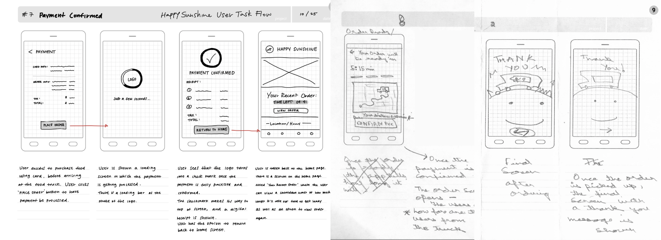
User Task Flow

Slide 24
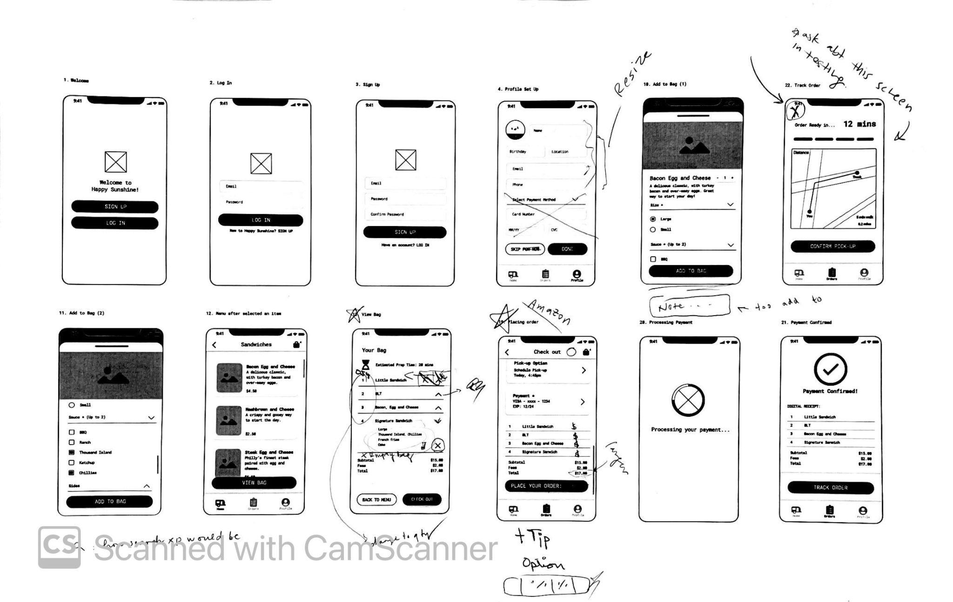
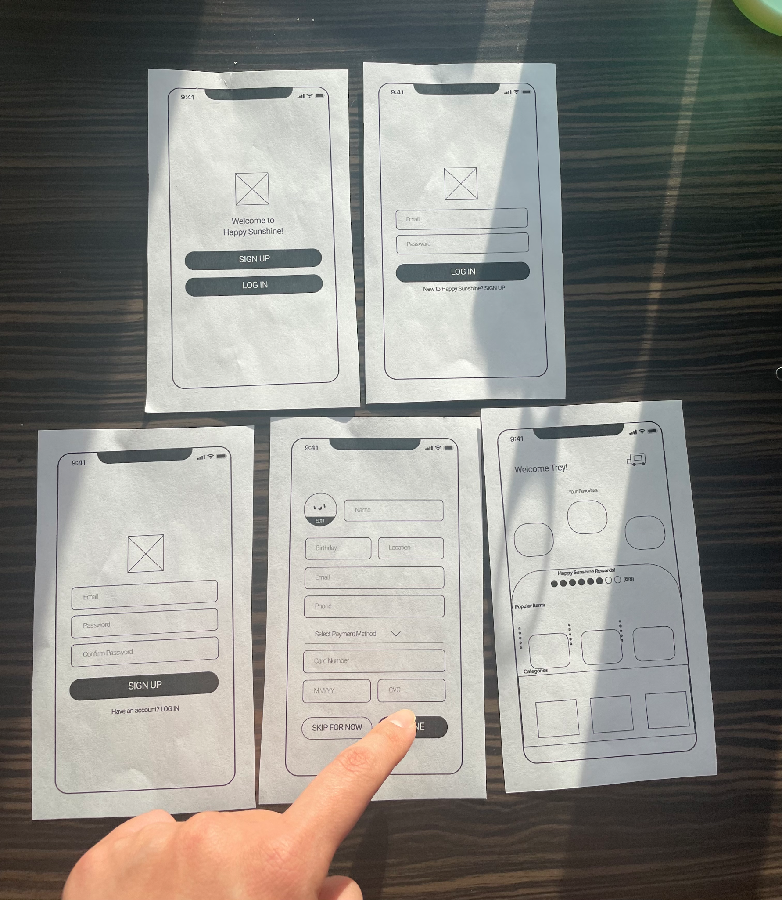
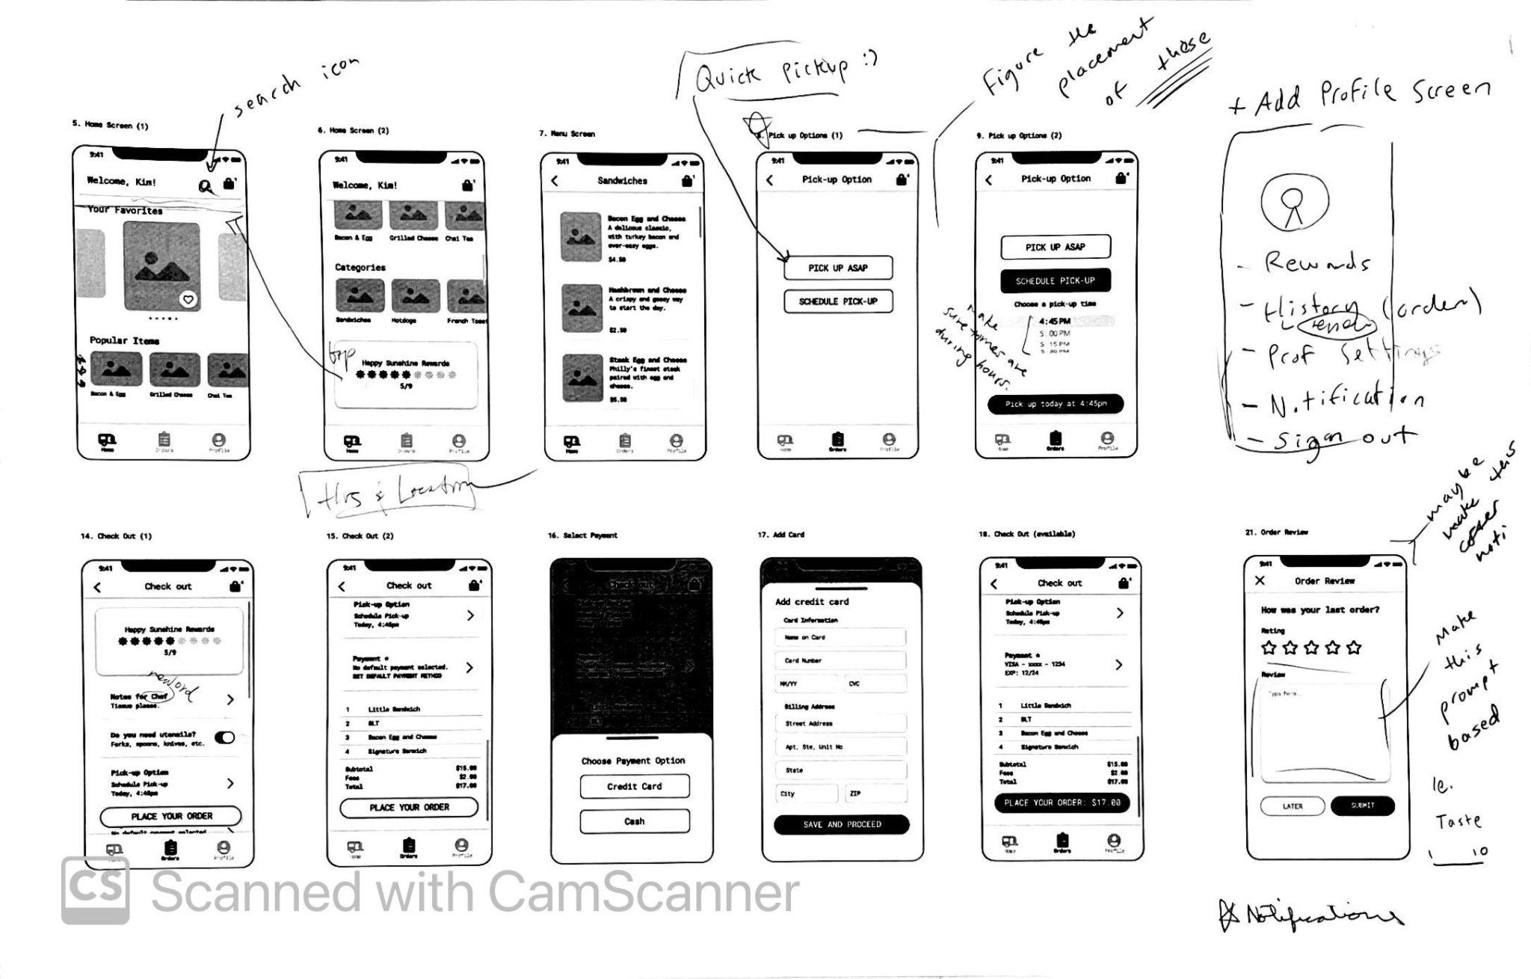
Paper Prototype

Slide 25
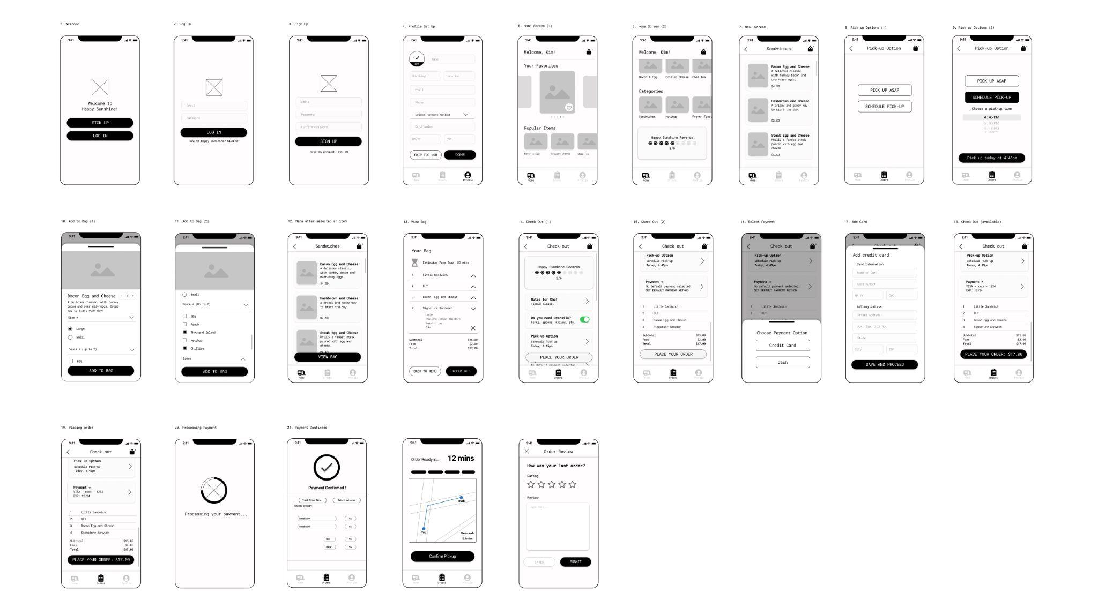
Low Fidelity

Slide 26
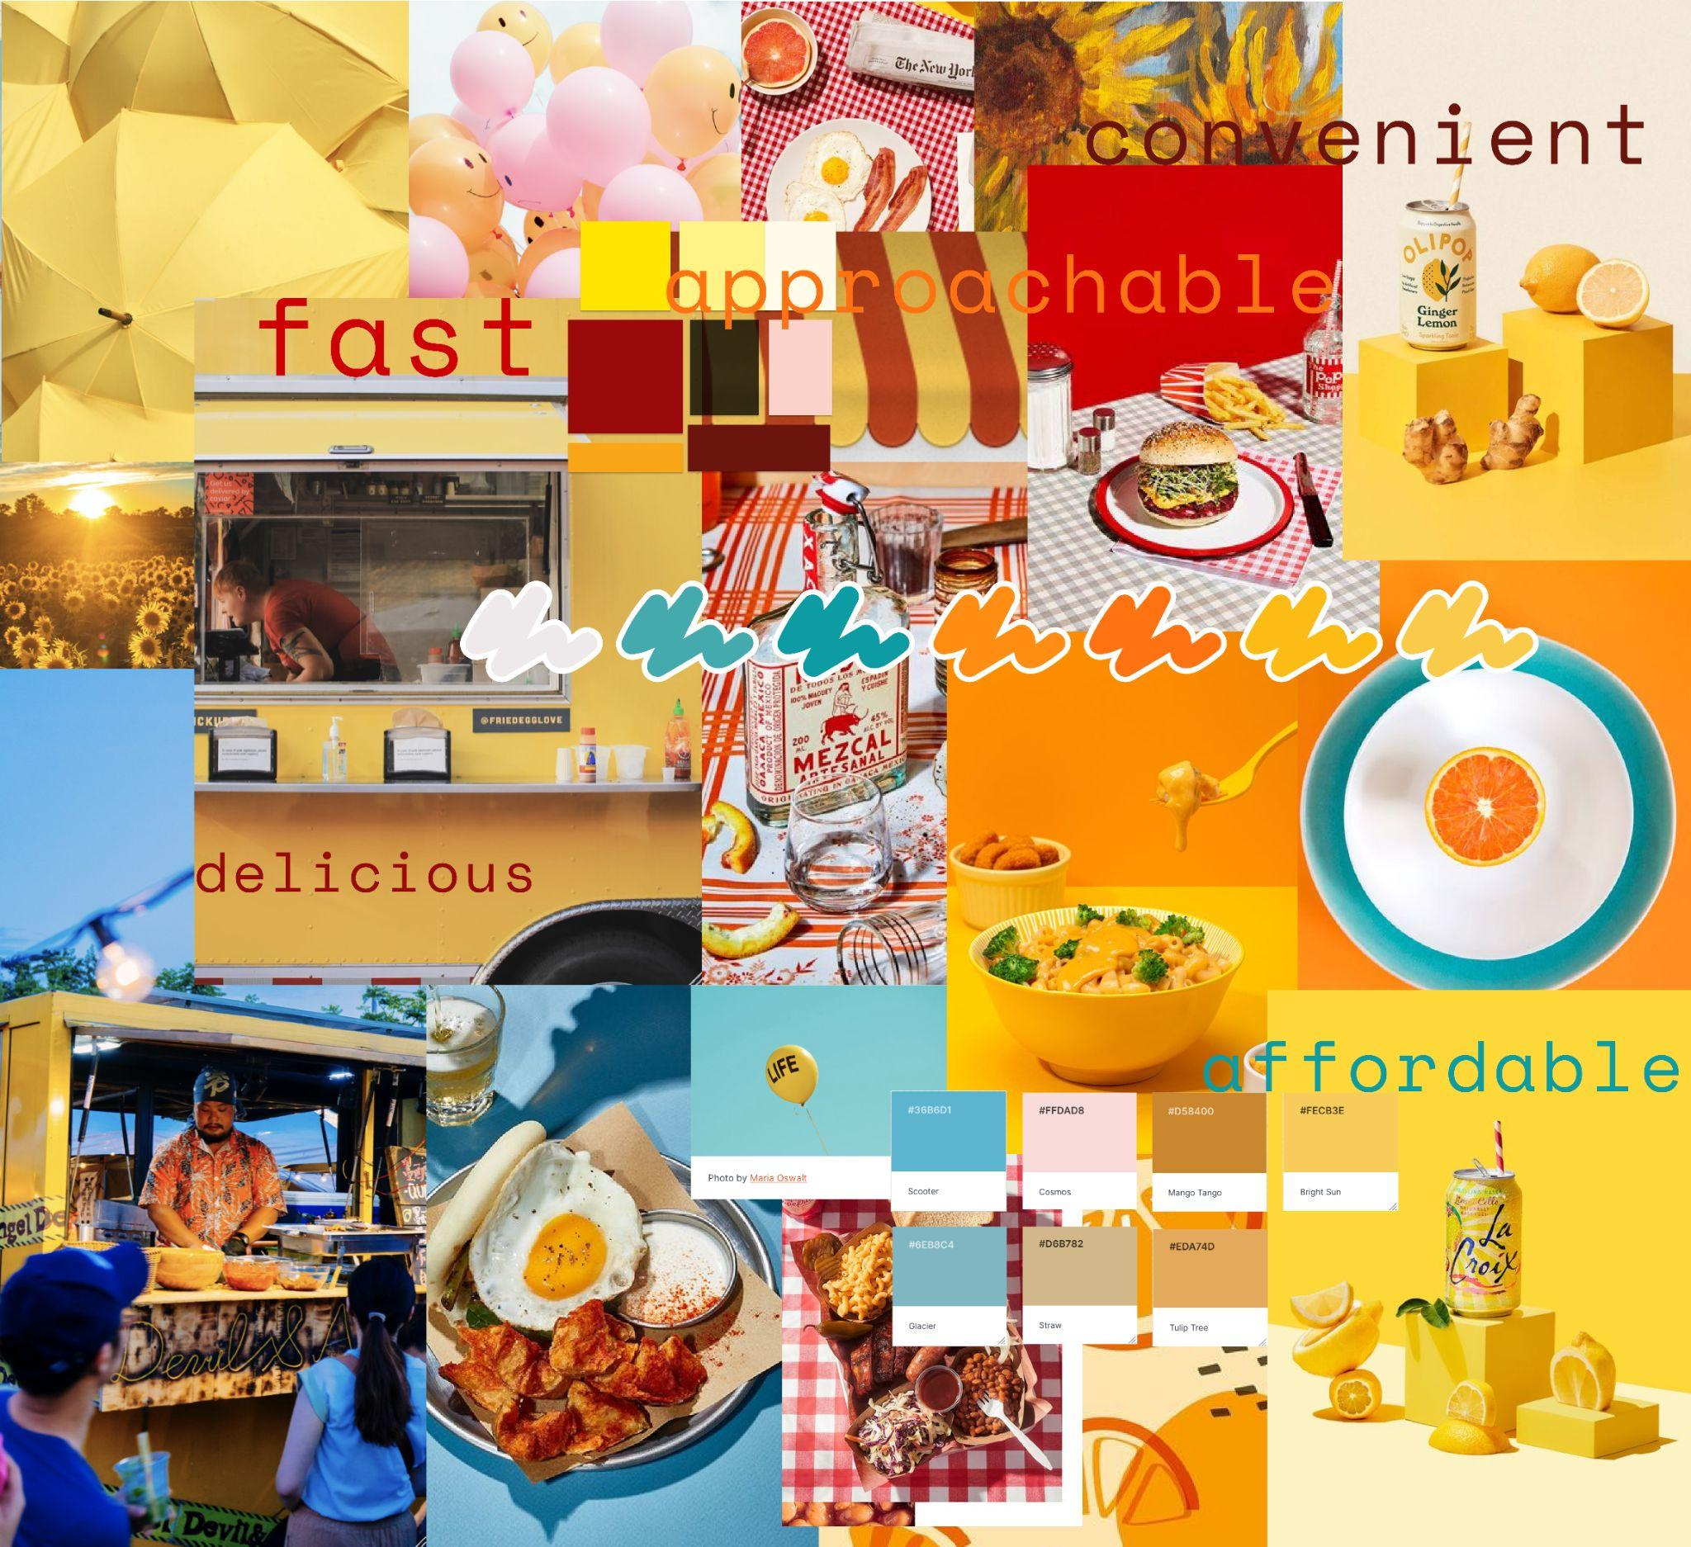
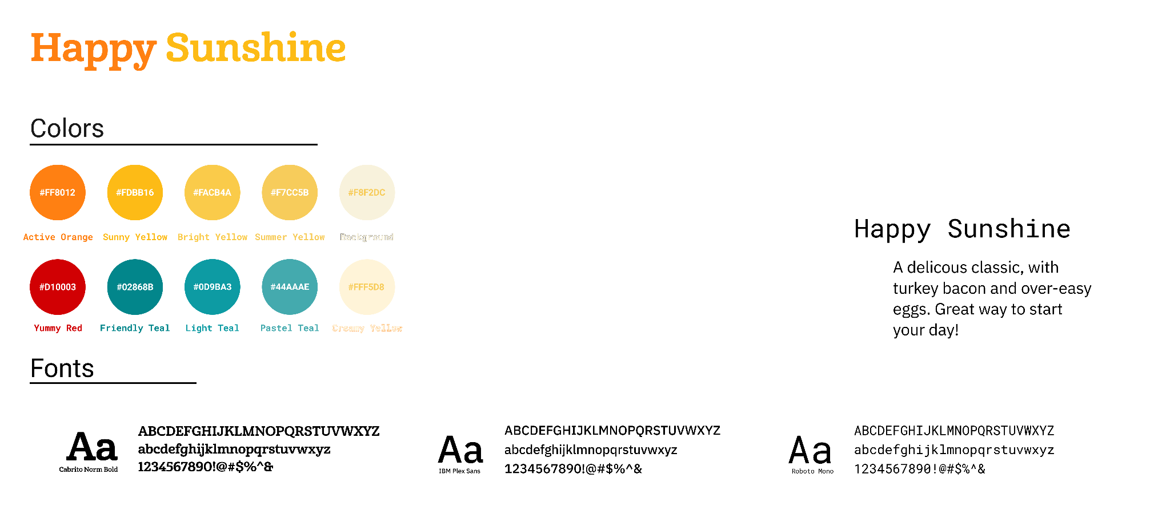

Slide 27
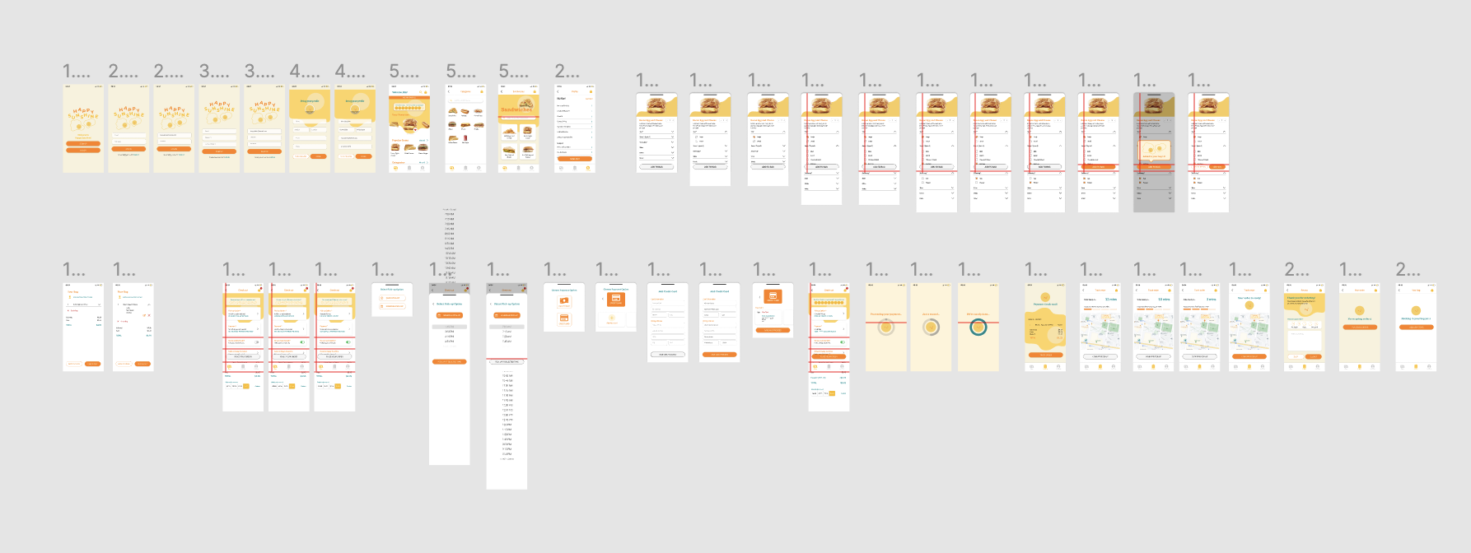
Mid Fidelity

Slide 28
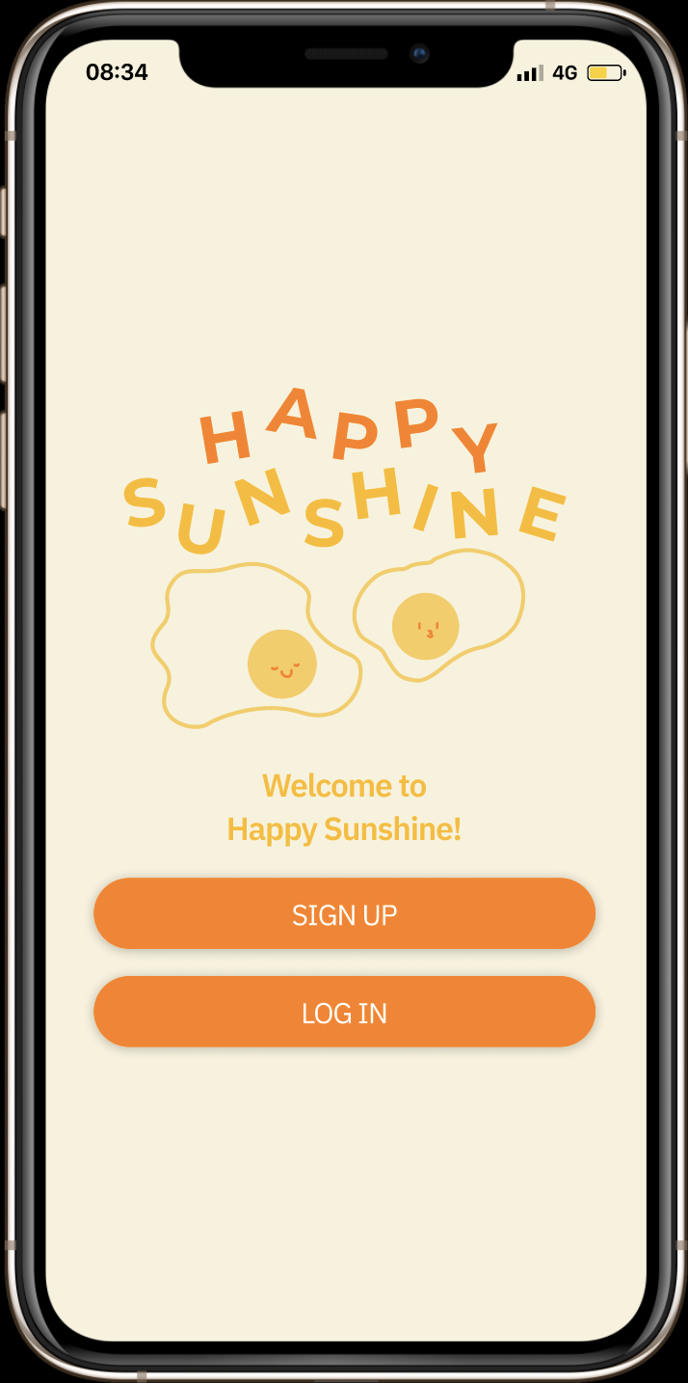

High Fidelity
Figma Prototype
Notes:
https://www.figma.com/proto/fY9eWdLmPD8ndQs79fPra6/IDM-215-TEAM-2-Happy-Sunshine?page-id=411%3A20607&node-id=411%3A20607&viewport=241%2C48%2C0.44&scaling=scale-down&starting-point-node-id=498%3A40916

Slide 29
DOWNLOAD THE APP NOW!

Slide 30
Thanks!
Do you have any questions?

